Slide 1
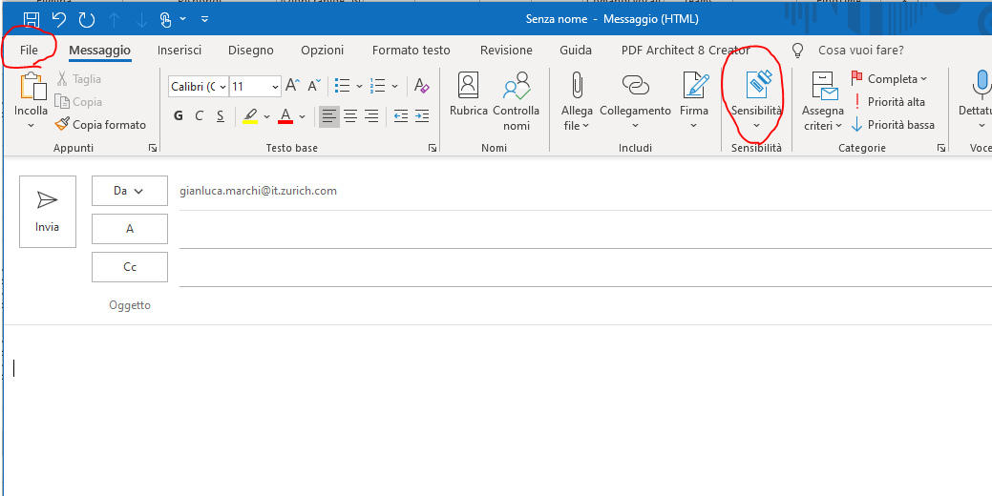
The following code launch Outlook, open the template.msg and fill all the needed info (from, to, cc, subject, etc.)
Manually create a new empty message with Outlook.
Then set appropriate sensitivity and save the empty (but sensitivity set) email in a folder (for example c:\temp\template.msg.
If you deal with different sensitivity email, just create a template for each one.
templateEmail=‘c://temp//template.msg’
outlook=win32.Dispatch('outlook.application').GetNamespace("MAPI")
mail=outlook.OpenSharedItem(templateEmail)
mail.From=‘xxx@xxx.com'
mail.To=‘zzz@zzz.com’
mail.Cc=‘yyy@yyy.com’
mail.Subject=‘subject’
mail.Body=‘Body Text’
attachment=‘c:\temp\test.xlsx’
mail.Attachments.Add(attachment)
mail.Send()

